Slide 1


Parity Measurements on Weakly Coupled Carbon Spins in Diamond
Michiel Adriaan Rol
Supervisors :
Ir. J.Cramer
Dr. Ir. T.H. Taminiau
Prof. Dr. Ir. R. Hanson
Performed at:
Quantum Transport group
Kavli Institute of Nanoscience
Delft University of Technology

Slide 2


A Quantum Computer promises an exponential speedup over conventional computers
Quantum Computer
Figure from The Economist: Quantum Computing feb 25th 2012

Slide 3
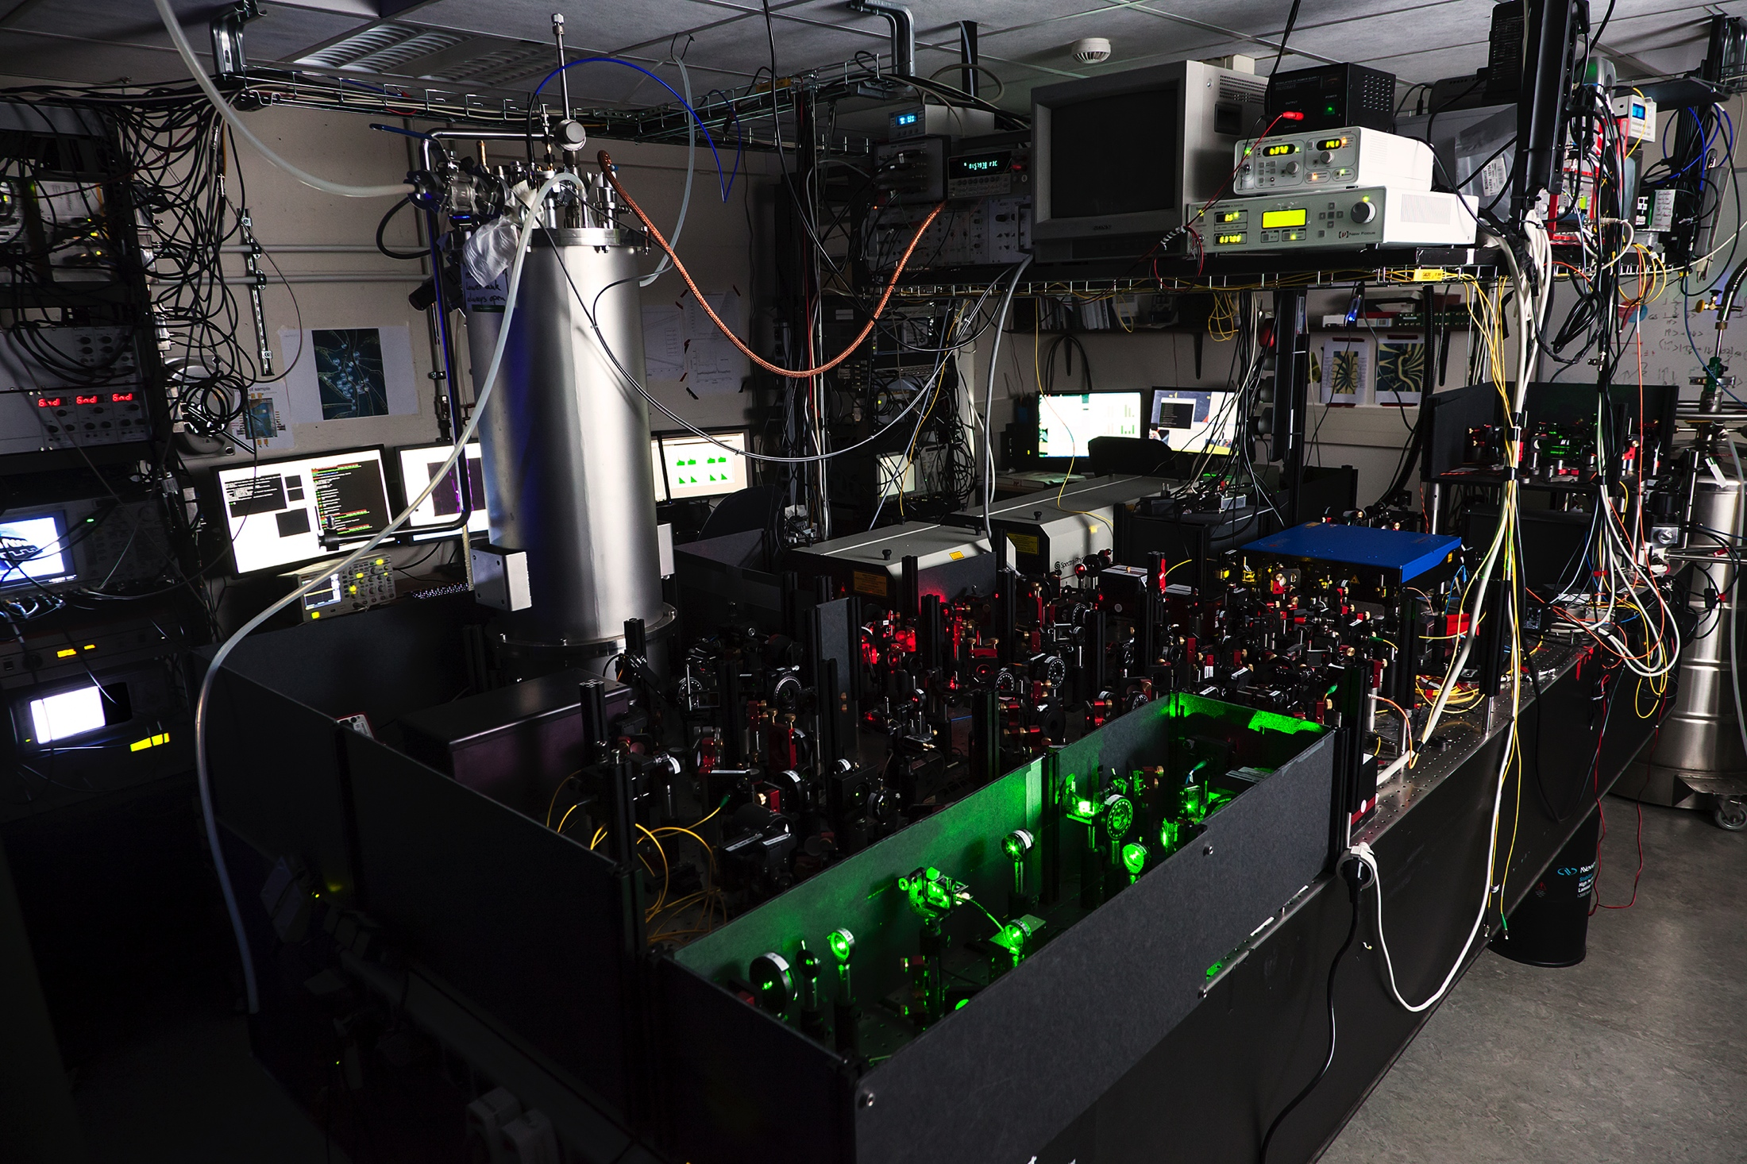
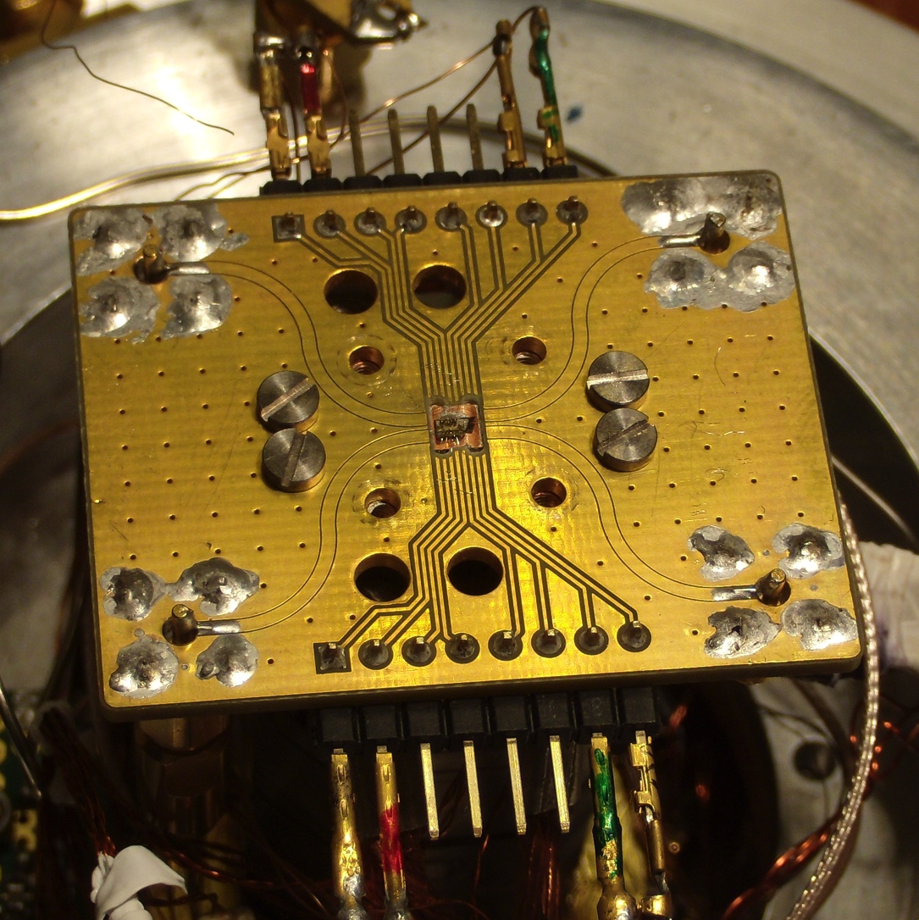
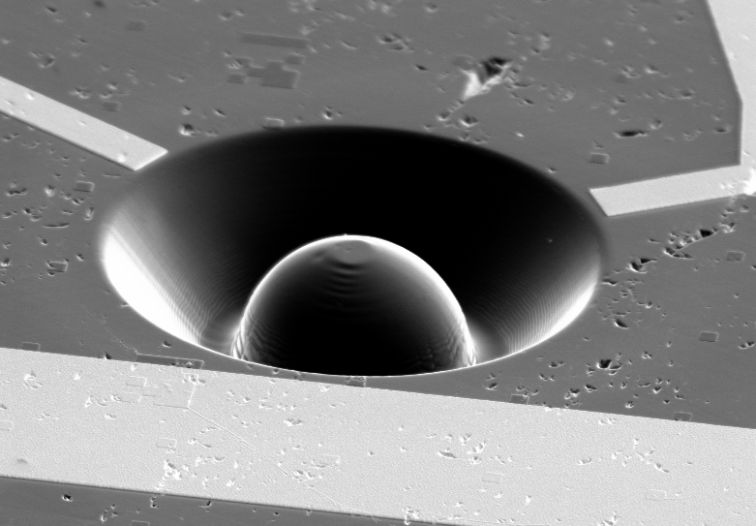

Slide 4


Parity Measurements on Weakly Coupled Carbon Spins in Diamond
Master Thesis Presentation Adriaan Rol
Short Introduction to Quantum Information
The NV-center
Parity Measurements
Quantum Error Correction
Notes:
Animatie: Dynamical decoupling
1 –pulse -> stuk groter
meerdere keren heen en weer bewegen -> Cirkel wordt stuk groter

Slide 5
A quantum computer uses qubits, the quantum analogue of classical bits
Classical Bits vs Quantum Bits
Bit
Qubit
0
1
50%
50%

Slide 6
Quantum error correction is essential in building a scalable quantum computer
Error Correction
Classical Error Correction
Quantum Error Correction ?
Copy the bit
An error occurs
Measure all bits
Majority vote recovers original
1
111
110
1
No Cloning Theorem
Copy the qubit
An error occurs
Measure all qubits
Majority vote recovers original
Measurements project
Notes:
Classical -> Errors Average out
Quantum -> Errors add up

Slide 7
Two particles are entangled if they cannot be described independent from each other
Entanglement
A
B
1
0
0
1
0
1
1
0
1
1
0
1
1
0
1
0
1
1
0
1
1
0
1
0
0
1
0
0
1
0
0
1
0
1
0
0
A
B

Slide 8
By measuring the parity an error can be diagnosed and corrected
3-qubit quantum error correction
1 Encode
2 Error
3 Diagnose by
parity measurment
4 Correct error
Tamniau et al. Nat Nano (2014), Waldherr et al. Nature (2014)
Reed et al. Nature (2012)

Slide 9
Parity Measurements on Weakly Coupled Carbon Spins in Diamond
Master Thesis Presentation Adriaan Rol
Short Introduction to Quantum Information
The NV-center
Parity Measurements
Quantum Error Correction
Notes:
Animatie: Dynamical decoupling
1 –pulse -> stuk groter
meerdere keren heen en weer bewegen -> Cirkel wordt stuk groter

Slide 10
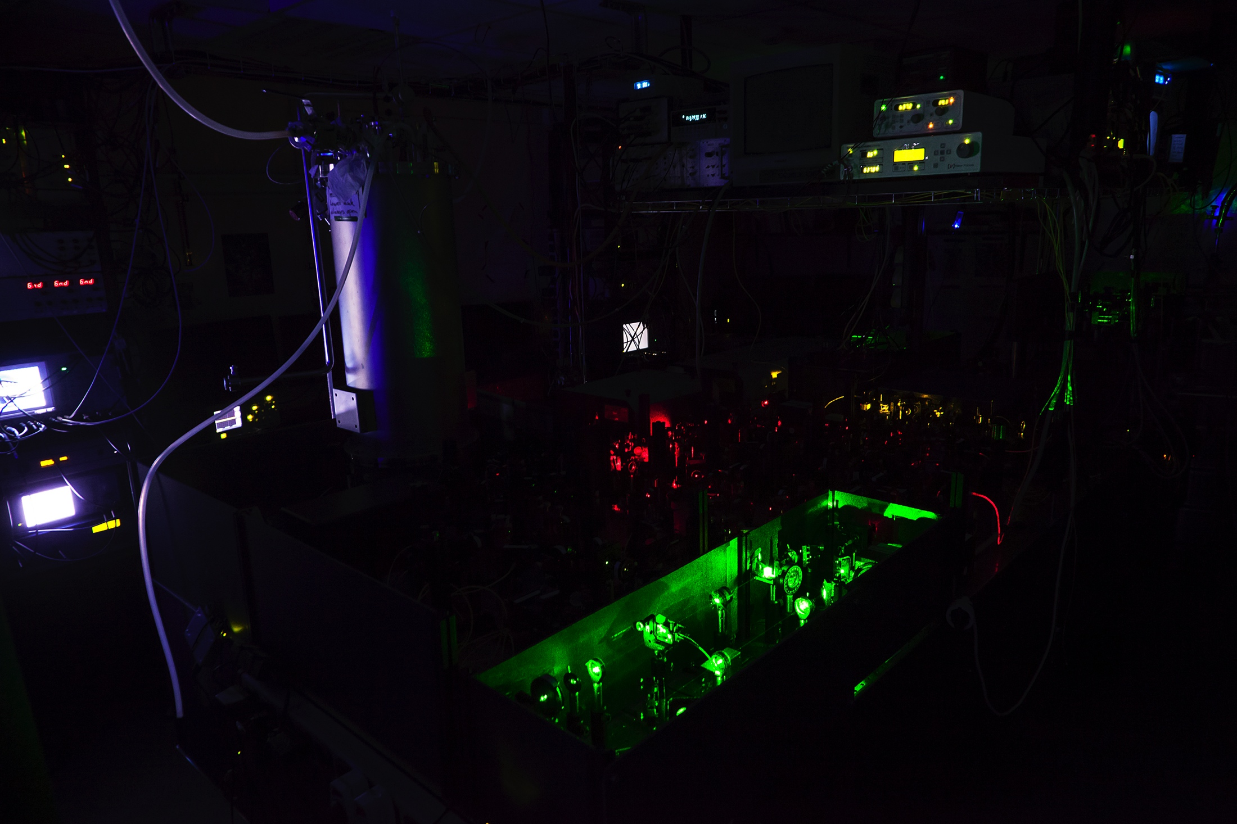

Slide 11

The NV-center is an impurity in Diamond of which we can contol the electronic spin
Introduction to the NV-center
The electronic spin can be read out with a laser pulse
The electronic spin can be rotated with microwave pulses
Notes:
Slide Showing optical Readout
Arrow up -> photon out
Arrow down-> no response
MW control, can turn purple spin around. (rotate the spin).

Slide 12
Carbon spins rotate around different axes depending on the electron state
Electron spin dependent carbon rotations
Notes:
Hyperfine interaction present for ms = +1, not present for ms=0

Slide 13
By repeatedly flipping the electron spin with careful timing we can control the carbon spin
Control of weakly coupled carbon spins trough dynamical decoupling
Taminiau et al. (2012) Phys. Rev. Let.

Slide 14
Using the control over the carbon and electron spin we can initialize carbon spins
Single qubit control
Carbon initialized in
X-readout
Y-readout
Z-readout

Slide 15
Parity Measurements on Weakly Coupled Carbon Spins in Diamond
Master Thesis Presentation Adriaan Rol
Short Introduction to Quantum Information
The NV-center
Parity Measurements
Quantum Error Correction
Notes:
Animatie: Dynamical decoupling
1 –pulse -> stuk groter
meerdere keren heen en weer bewegen -> Cirkel wordt stuk groter

Slide 16
A Parity measurement measures if two qubits point in the same direction
Parity measurement
Pfaff et al. Nat. Phys. 2012
Notes:
Go over examples,
Let audience guess what the outcome will be
Explain that it also works on entangled states.

Slide 17
We use a tomography to characterize a state
2 qubit tomography

Slide 18
We perform a parity measurement by mapping the parity on the electron state
Parity meaurement on weakly coupled carbon spin
XX
The electron is brought into
The electron picks up
By doing this twice the electron picks up πphase if both carbons point in the same direction along x and no phase if they do not
Measuring the electron projects the state
phase if the carbon is in
phase if the carbon is in

Slide 19
Performing a parity measurement can project into an entangled state
Projecting in an entangled state
?
XX

Slide 20
The parity measurement is demonstrated by the creation of entanglement
Entangled state

Slide 21
Parity Measurements on Weakly Coupled Carbon Spins in Diamond
Master Thesis Presentation Adriaan Rol
Short Introduction to Quantum Information
The NV-center
Parity Measurements
Quantum Error Correction
Notes:
Animatie: Dynamical decoupling
1 –pulse -> stuk groter
meerdere keren heen en weer bewegen -> Cirkel wordt stuk groter

Slide 22
Quantum error correction requires deterministic parity measurements and more qubits
Challenges for Quantum Error Correction
Deterministic parity measurements
XX
Three or more qubits
Risté et al. Nature 2013

Slide 23
Simulations indicate that it is possible to address 3 or more carbons
Result of Simulations
μ=1.10%
μ=0.33%
μ=0.11%
μ = 1.10%
B = 700G

Slide 24
Parity Measurements on Weakly Coupled Carbon Spins in Diamond
Master Thesis Presentation Adriaan Rol
Short Introduction to Quantum Information
The NV-center
Parity Measurements
Quantum Error Correction
Notes:
Animatie: Dynamical decoupling
1 –pulse -> stuk groter
meerdere keren heen en weer bewegen -> Cirkel wordt stuk groter

Slide 25
Parity Measurements on Weakly Coupled Carbon Spins in Diamond
Michiel Adriaan Rol
Supervisors :
Ir. J.Cramer
Dr. Ir. T.H. Taminiau
Prof. Dr. Ir. R. Hanson
Performed at:
Quantum Transport group
Kavli Institute of Nanoscience
Delft University of Technology

Slide 26
Using a dynamical decoupling spectroscopy we can identify individual spins
Dynamical decoupling spectroscopy

Slide 27
Different NV-centers can be linked together using the optical interface
Teleportation and distant entanglement
Unconditional quantum teleportation between diamond spins over 3m
Bernien et al. Nature 497, 86 (2013);
Pfaff et al. Science 345, 532 (2014)

Slide 28
Coherence times
Ramsey and Spin Echo
Source: De Lange et al. Science (2010) DOI: 10.1126/science.1192739
Notes:
TDD > 40 ms was measured at N = 256 pulses, no end in sight yet.

Slide 29


By repeatedly flipping the electron spin with careful timing we can control the carbon spin
not on resonance
precisely on resonance

Slide 30
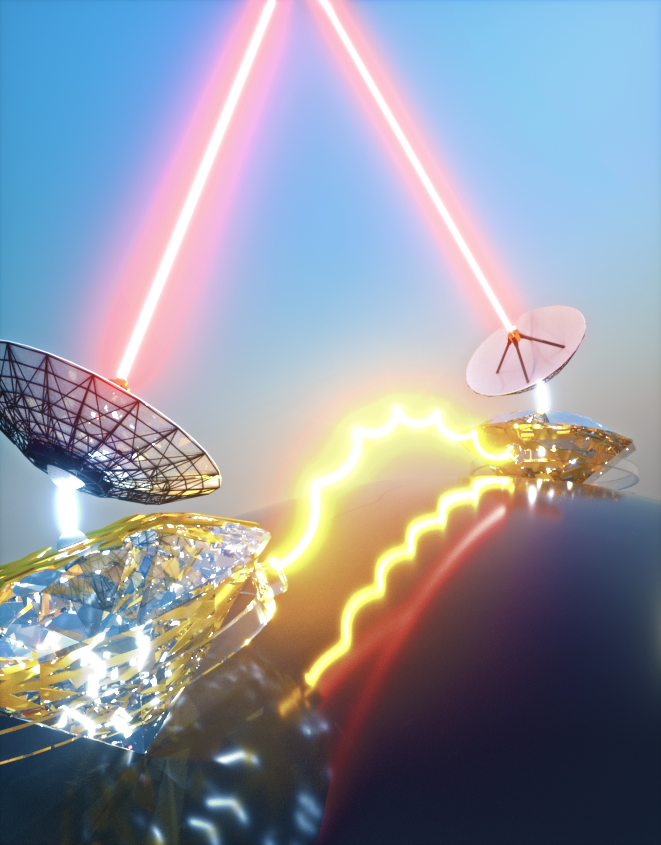
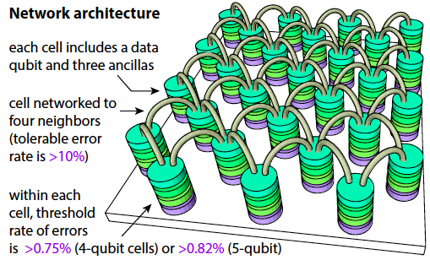
The unique combination of local spin control and an optical interface allows a node based design
Long-term motivation
Quantum Internet
Surface code quantum computing
Secure quantum communication
Quantum cloud computing
Nickerson, Li, Benjamin,
Nature Communication 2013
Barz et al., Science 2012
Notes:
30

